Slide 1
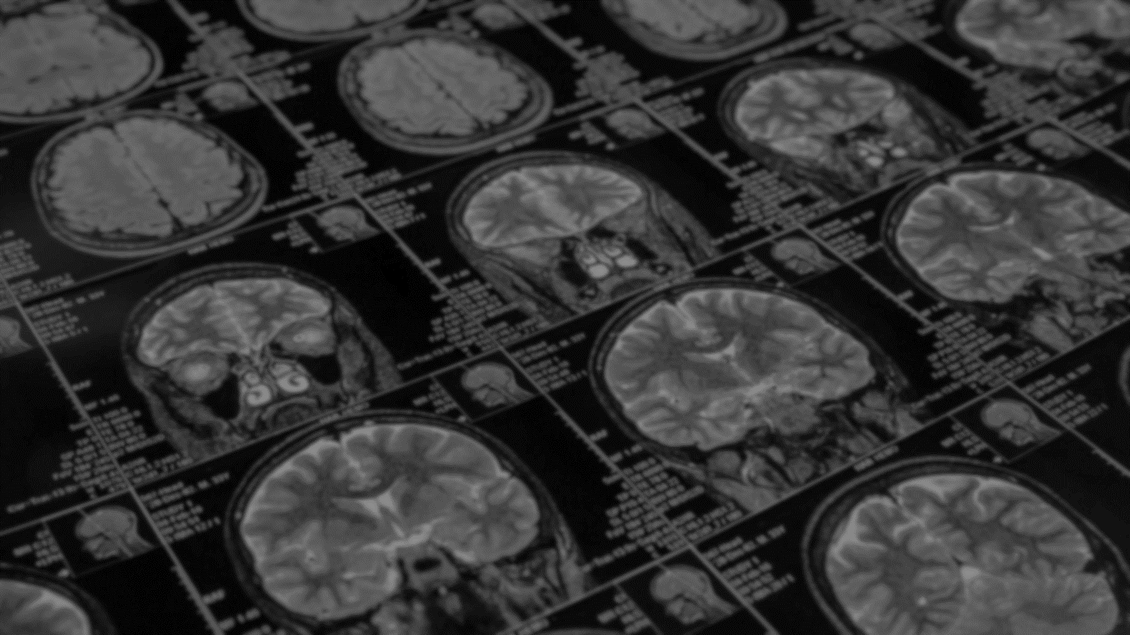

BRAIN.MRI A CNN based approach to detecting Alzheimer’s Disease using Brain MRI scans
2
+
2
+
SEM V MINI PROJECT
AYTIJHA CHAKRABORTY
BTECH(CSE-AI/ML)
SEC K, ROLL 15
UNIVERSITY ROLL 1914009

Slide 2
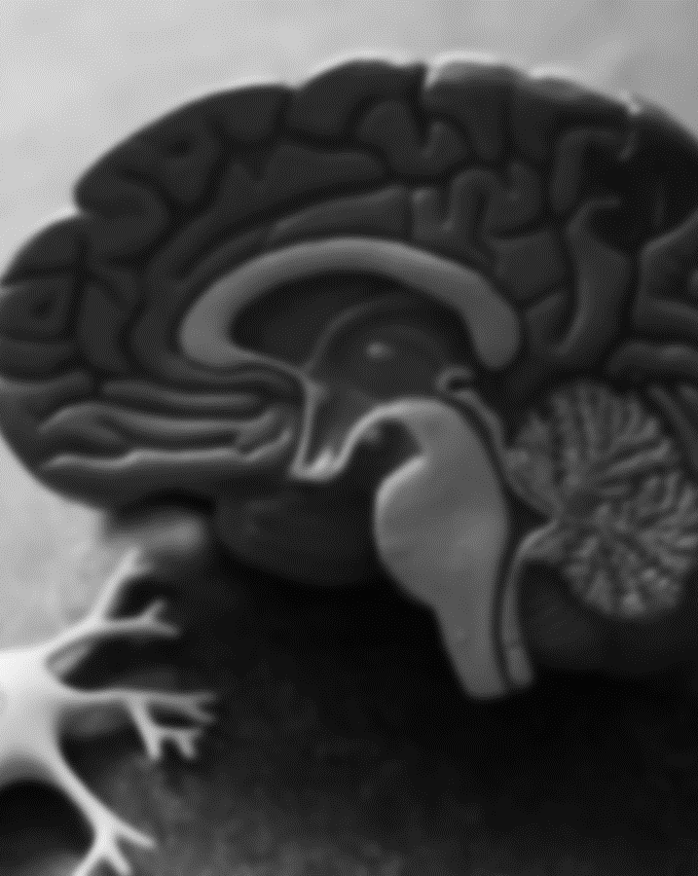
Alzheimer’s disease
2
+
AND IT’S EFFECTS
Alzheimer’s disease is a brain disorder that slowly destroys memory and thinking skills and, eventually, the ability to carry out the simplest tasks. In most people with the disease — those with the late-onset type symptoms first appear in their mid-60s. Early-onset Alzheimer’s occurs between a person’s 30s and mid-60s and is very rare. Alzheimer’s disease is the most common cause of dementia among older adults.
The damage initially takes place in parts of the brain involved in memory, including the entorhinal cortex and hippocampus. It later affects areas in the cerebral cortex, such as those responsible for language, reasoning, and social behavior. Eventually, many other areas of the brain are damaged.

Slide 3
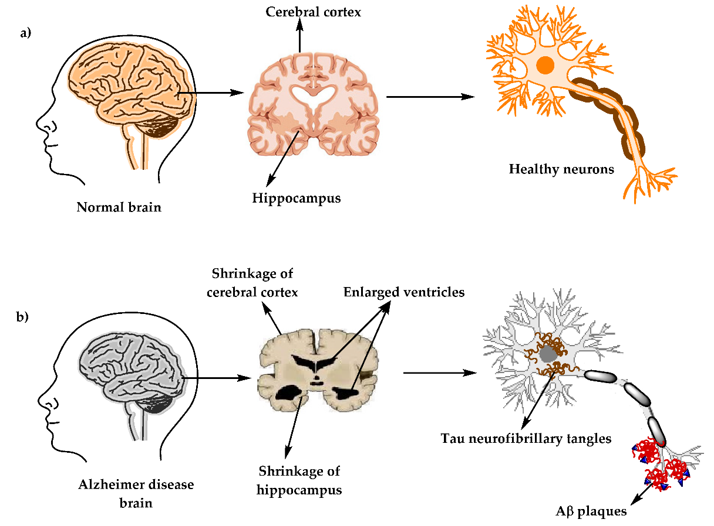
an Alzheimer’s affected brain

Slide 4
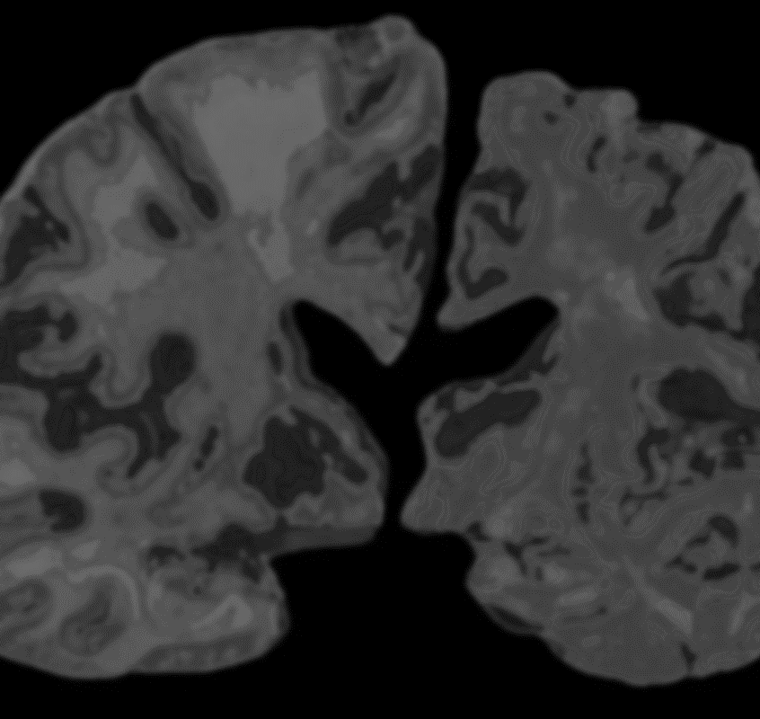
Magnetic resonance imaging
2
+
AND MEDICAL IMAGING TECHNIQUES
Magnetic resonance imaging (MRI) is a medical imaging technique that uses a magnetic field and computer-generated radio waves to create detailed images of the organs and tissues in your body.
Most MRI machines are large, tube-shaped magnets. When you lie inside an MRI machine, the magnetic field temporarily realigns water molecules in your body. Radio waves cause these aligned atoms to produce faint signals, which are used to create cross-sectional MRI images — like slices in a loaf of bread.
A functional MRI of the brain (fMRI) produces images of blood flow to certain areas of the brain and can be used to assess damage from a head injury or from disorders such as Alzheimer's disease.

Slide 5
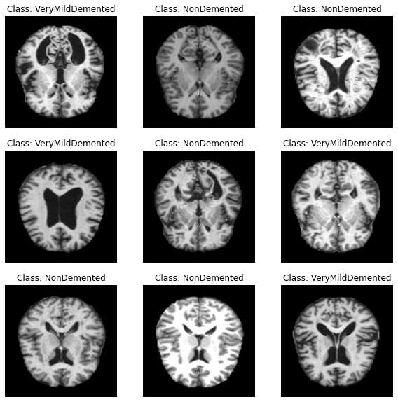
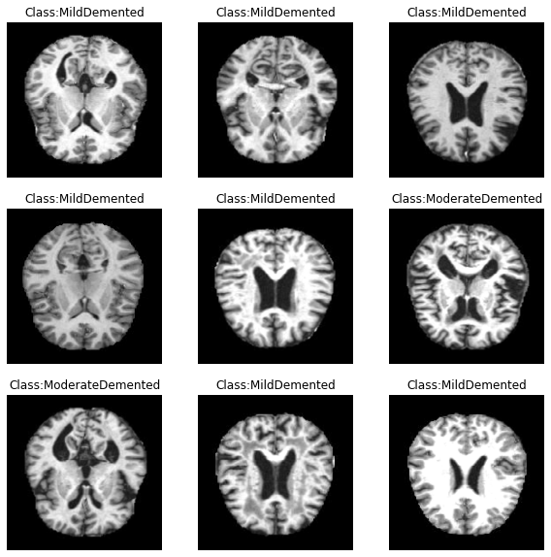
Functional mri (fmri) samples

Slide 6
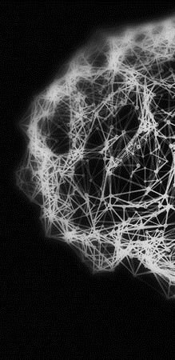
PROJECT ABSTRACT
PROJECT MODULES
This project (named BRAIN.MRI) is an implementation of an Alzheimer’s Detection System. This means that upon being provided the MRI of the patient’s Brain, the presence and stage/type of Alzheimer’s can be accurately detected.
This is done using a Deep Learning model that utilizes the power of Convolutional Neural Networks (CNNs).
When validated over 4 classes of Image data, the model gave an accuracy of 98.88%.
The pipeline of the project includes three components:
Data Acquiring and Preprocessing [Python modules Used: ImageDataGenerator (TensorFlow), SMOTE (Imbalanced-Learn)]
Model Training and Evaluation [Python modules Used: TensorFlow, OpenCV, Scikit-Learn, NumPy]
GUI [Technologies Used: Flask (Python), HTML, CSS, Bootstrap, JavaScript]

Slide 7
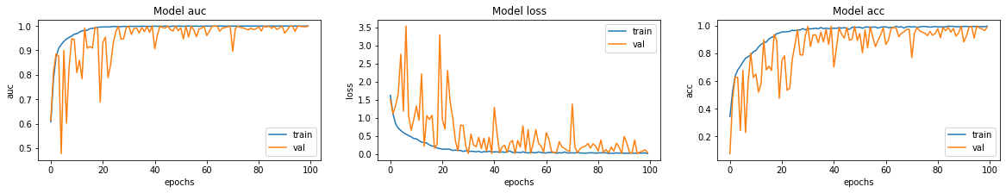

DFD
Model Metrics

Slide 8
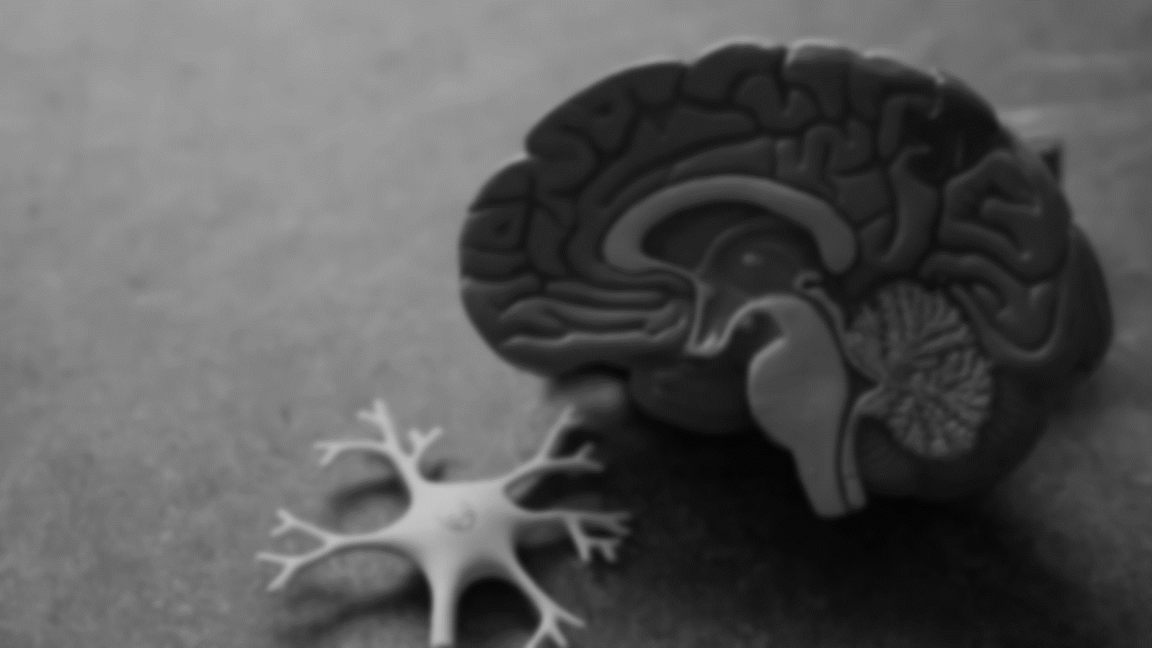
THANK YOU
2
+

